Slide 1
Soccer Tracking APP

Slide 2
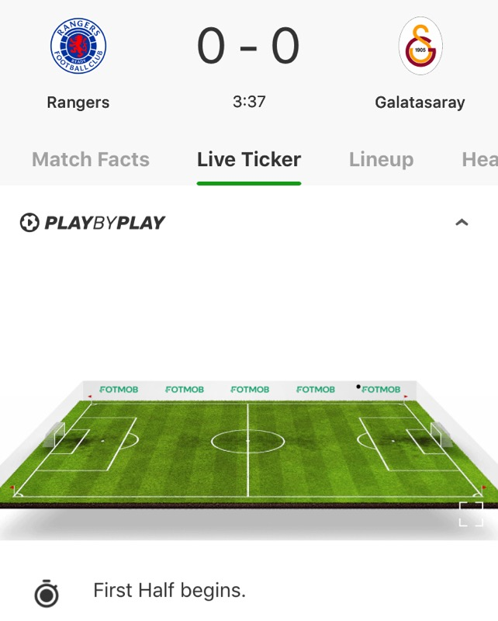
Problem to be addressed
Current sports apps have a poor system of displaying how games are playing in real time.
The image on the right is how most apps displays match info in real time.
Most games do not get play by play (This is speculation), because it requires a person to input the actions happening in the game.

Slide 3

Goals
Take in video of soccer match, and produce Top down view. Using this Top down view we process the income video so that we are be able to use open-CV blob detection to track player Movements

Slide 4
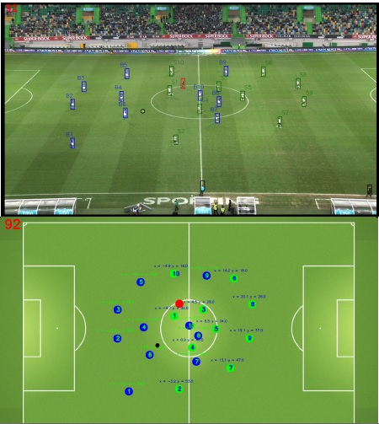
References, and use case
The idea for this project came from the paper:
“A computer vision based web application for tracking soccer players”
by the authors :J.M.F. Rodrigues, P.J.S. Cardoso, T. Vilas, S. Bruno, P. Rodrigues, A. Belguinha, and C. Gomes
In which they gave an example of some what I hope to achieve with this project.

Slide 5
Elements
Python Libraries
Video / Training Data
Numpy
Python OpenCV
Real Game Footage
Video Captured from FIFA 20
Cleaning / Removing video that is zoomed in on one player, or is a replay

Slide 6


Possible Road blocks
The OpenCV python is incredibly large, and it might take some time to get comfortable with it
Using actual game footage might be hard to get because most professional Soccer footage is copyrighted
Need to have a backup plan that I can pivot to if the slope of the project becomes to difficult

Slide 7
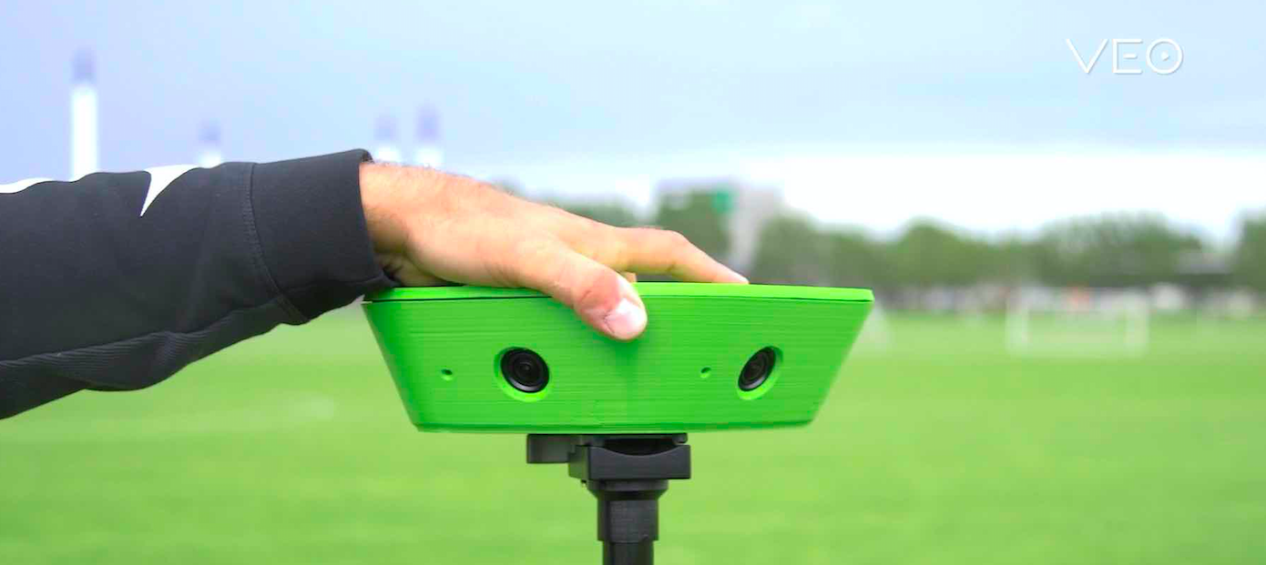
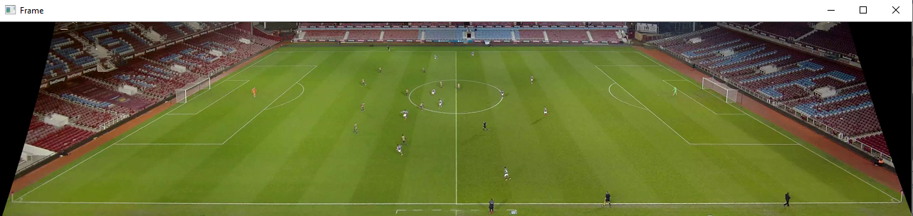
Application Requirements
Currently the application needs a panoramic view of a soccer field. Meaning that it is a video that has a view of the entire field without having to move or pan. While this is not your average video there are companies like “Veo” that rents out the equipment required to record such a video.

Slide 8
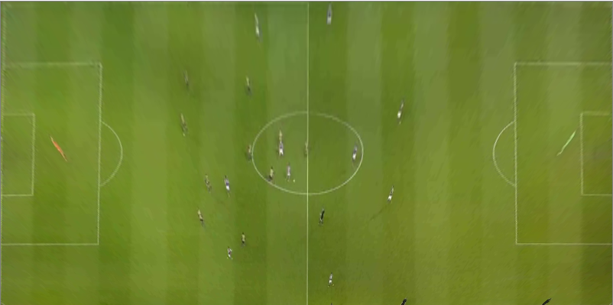
Operation of Application
The application first prompts the user to select the 4 corners of the field. After select the 4 corners the points are taken the field is cut to remove excess, and then the remain field is warped to produce a Top down view of the field. This top down is processed using HSV, and other filter to return a bit-image then blob detection is used to determine where the players are

Slide 9
Top Down View

Slide 10
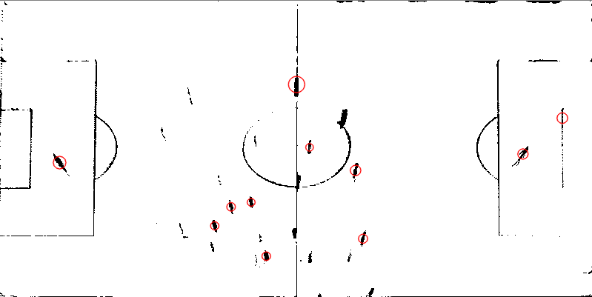
Top Down Bit-Image

Slide 11
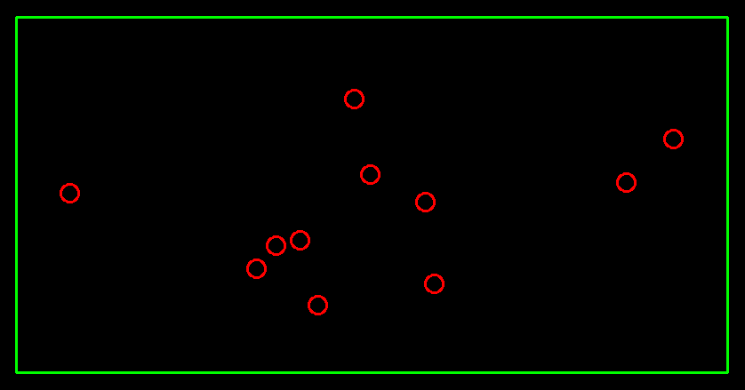
Final Return of the App

Slide 12
Continuing Development
Features still needed to be implemented:
Better Blob Detection Parameters
Better Image filtering, and Processing
Line Detection, and projection
Better user interface
Heatmap of Player movement for analysis

Slide 13
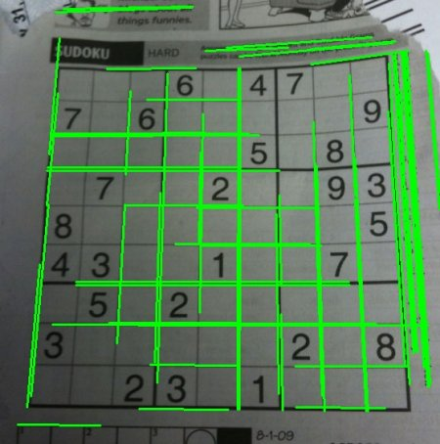
Line Detection
For mine application’s line detection feature I will likely use Hough Line Transform. Which should allow me to more easy project the lines of the 18 yard box on to the final return of the application.

Slide 14
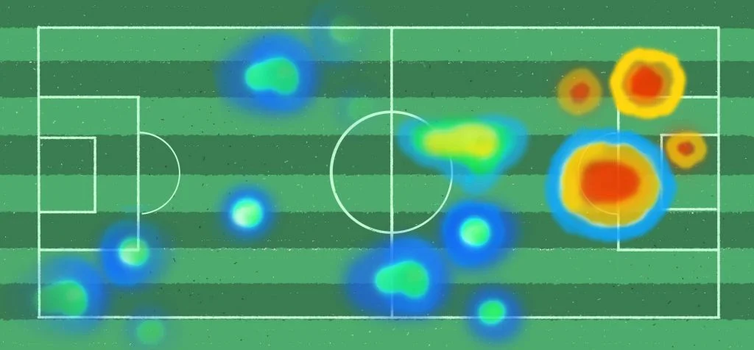
Heatmap
Adding a heatmap to my project might be one of the more ambitious goals. It could be done by saving all of the detection results, and laying them over each. However during this project I do not think that I would be able to break the heatmap down by individual players.

Slide 15
Demonstration

